Slide 1

Dimitris Papailiopoulos
Convergence Rates of Hogwild!

Slide 2
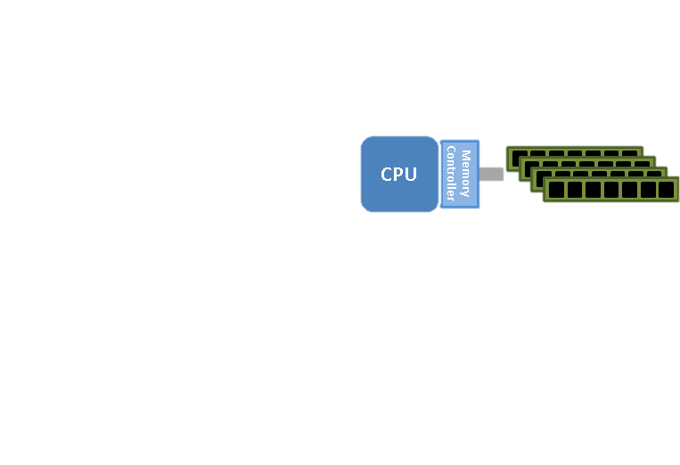
Today
Single Machine, Multi-core

Slide 3

Today
Asynchronous
Processor 1
Processor 2
Processor P

Slide 4
SGD on sparse functions
Def:
Hyperedge = the subset of variables that depends on
The function-variable graph
Matrix Fact./Comp.
Graph cuts
Graph/text Classification
Topic Modeling
Dropout
…

Slide 5
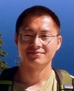




HOGWILD! 2011
“Run parallel lock-free SGD without synchronization”
Niu
Recht
Ré
Wright
SVM RCV1 (10 cores)
Each processor in parallel
Impact
Downpour SGD, Project Adam use HOGWILD!
Renewed interest on async. optimization

Slide 6
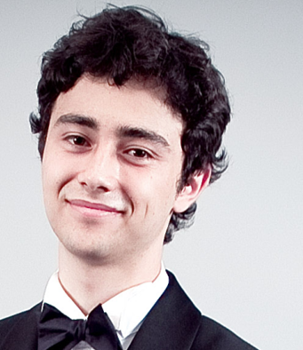



A Noisy Lens for Asynchronous Algorithms
Main Idea
Noisy viewpoint:
Asynchronous(Algo.( INPUT )) Serial(Algo.(INPUT + Noise)
Perturbed Iterate Analysis for Asynchronous Stochastic Optimization
[Mania, Pan, P, Recht, Ramchandran, Jordan, 2015]
Joint work with

Slide 7
HOGWILD! as noisy SGD
Each processor in parallel
Def: is the k-th sampled data point
Fact: Cores don’t read “actual” iterates but “noisy iterates”
After T processed samples, the contents of RAM are:
(atomic writes + commutativity)
Ex.

Slide 8
HOGWILD! as noisy SGD
Each processor in parallel
Def: is the k-th sampled data point
Fact: Cores don’t read “actual” iterates but “noisy iterates”
After T processed samples, the contents of RAM are:
(atomic writes + commutativity)
Ex.
Core 1
Core 2
Core 3
RAM
1
0
0
050
017
000

Slide 9
HOGWILD! as noisy SGD
Each processor in parallel
Def: is the k-th sampled data point
Fact: Cores don’t read “actual” iterates but “noisy iterates”
After T processed samples, the contents of RAM are:
(atomic writes + commutativity)
Ex.
Core 1
Core 2
Core 3
RAM
1
0
0
050
017
000

Slide 10
HOGWILD! as noisy SGD
Each processor in parallel
Def: is the k-th sampled data point
Fact: Cores don’t read “actual” iterates but “noisy iterates”
After T processed samples, the contents of RAM are:
(atomic writes + commutativity)
Ex.
Core 1
Core 2
Core 3
RAM
1
0
0
050
017
050

Slide 11
HOGWILD! as noisy SGD
Each processor in parallel
Def: is the k-th sampled data point
Fact: Cores don’t read “actual” iterates but “noisy iterates”
After T processed samples, the contents of RAM are:
(atomic writes + commutativity)
Ex.
Core 1
Core 2
Core 3
RAM
1
0
0
050
017
050

Slide 12
HOGWILD! as noisy SGD
Each processor in parallel
Def: is the k-th sampled data point
Fact: Cores don’t read “actual” iterates but “noisy iterates”
After T processed samples, the contents of RAM are:
(atomic writes + commutativity)
Ex.
Core 1
Core 2
Core 3
RAM
1
0
0
050
017
150

Slide 13
HOGWILD! as noisy SGD
Each processor in parallel
Def: is the k-th sampled data point
Fact: Cores don’t read “actual” iterates but “noisy iterates”
After T processed samples, the contents of RAM are:
(atomic writes + commutativity)
Ex.
Core 1
Core 2
Core 3
RAM
1
0
0
050
017
160

Slide 14
HOGWILD! as noisy SGD
Each processor in parallel
Def: is the k-th sampled data point
Fact: Cores don’t read “actual” iterates but “noisy iterates”
After T processed samples, the contents of RAM are:
(atomic writes + commutativity)
Ex.
Core 1
Core 2
Core 3
RAM
1
0
0
050
017
167

Slide 15
HOGWILD! as noisy SGD
Each processor in parallel
Def: is the k-th sampled data point
Fact: Cores don’t read “actual” iterates but “noisy iterates”
After T processed samples, the contents of RAM are:
(atomic writes + commutativity)
The algorithmic progress is captured by ``phantom” iterates
Main Questions:
Where does noise come from?
How strong is it?

Slide 16
Convergence Rates for Noisy SGD
We want to analyze noisy SGM
Elementary analysis (using m-strong convexity assumption on f):
Simple Lemma:
if both terms = ,
Noisy SGD gets same rates as SGD (up to multiplicative constants)
aka SGD robust to small perturbations
So.. is asynchrony noise small?

Slide 17
Understanding Asynchrony Noise
timeline
CPU 1
Sample 1
CPU 2
Sample 2
CPU 3
Sample 3

Slide 18
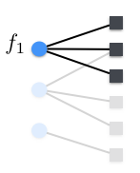
Understanding Asynchrony Noise
timeline
CPU 1
Sample 1
CPU 2
Sample 2
CPU 3
Sample 3
“Serialized” Processing Timeline

Slide 19
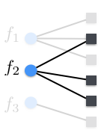
Understanding Asynchrony Noise
timeline
CPU 1
Sample 1
CPU 2
Sample 2
CPU 3
Sample 3
“Serialized” Processing Timeline

Slide 20
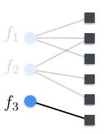
Understanding Asynchrony Noise
timeline
CPU 1
Sample 1
CPU 2
Sample 2
CPU 3
Sample 3
“Serialized” Processing Timeline

Slide 21
Understanding Asynchrony Noise
timeline
CPU 1
Sample 1
CPU 2
Sample 2
CPU 3
Sample 3
“Serialized” Processing Timeline
Asynchrony noise is combinatorial
coordinates in conflict can be as noisy as possible.
(no generative model assumptions)
Q: What causes asynchrony “noise”? A: “noisy reads” of the coordinates in the overlap

Slide 22
Convergence Rates for Hogwild!
Let’s now analyze “noisy” SGD:
Assumption: no more than samples processed, while a core is processing one
Eg, = 3
while 1 is being processed no more than
Important Note:
If is done before is sampled:
its gradient contribution is recorded in shared RAM,
when a thread starts working on
If overlaps in time with (i.e., the two samples are concurrently processed) :
its gradient contribution is only partially recorded in shared RAM,
when a thread starts working on
timeline
1
2
3
4
5

Slide 23
Convergence Rates for Hogwild!
Assumption: no more than samples processed, while a core is processing one
For each sample
Any difference between and caused only by samples that “overlap” with
Therefore
If is sampled before it might overlap with iff
If is sampled after , it might overlap with iff
Hence:
timeline
1
2
3
4
5

Slide 24
Convergence Rates for Hogwild!
Let’s now analyze “noisy” SGD:
Assumption: no more than samples processed, while a core is processing one
Elementary analysis (using m-strong convexity assumption on f):
timeline
1
2
3
4
Lemma:
if = O( )
Noisy SGD gets same rates as SGD (up to multiplicative constants)
Q: Is asynchrony noise that small?

Slide 25
Asynchrony Noise
The main thing we need to bound
We just used
Reminder: we need it smaller than
Reminder: we need it smaller than

Slide 26
Asynchrony Noise
The main thing we need to bound
Note: Asynchrony causes error if sampled grads overlap.
Simple Idea:
Samples might be concurrently processed, but they only “interfere” if they are talking to the same variables:
Reminder: we need it smaller than
timeline
Sample 1
Sample 2
If the interference is “rare” the noise term should be small

Slide 27
Asynchrony Noise
The main thing we need to bound
Note: Asynchrony causes error if sampled grads overlap.
Simple Idea:
Samples might be concurrently processed, but they only “interfere” if they are talking to the same variables:
Reminder: we need it smaller than
timeline
Sample 1
Sample 2

Slide 28
Asynchrony Noise
The main thing we need to bound
Note: Asynchrony causes error if sampled grads overlap.
Simple Idea:
Samples might be concurrently processed, but they only “interfere” if they are talking to the same variables:
Reminder: we need it smaller than
timeline
Sample 1
Sample 2

Slide 29
Asynchrony Noise
The main thing we need to bound
Note: Asynchrony causes error if sampled grads overlap.
Simple Idea:
Samples might be concurrently processed, but they only “interfere” if they are talking to the same variables:
Reminder: we need it smaller than
Bad Event
timeline
If the functions sampled share variables
Sample 1
Sample 2
Good Event
If the functions sampled do not share variables

Slide 30
Asynchrony Noise
The main thing we need to bound
Note: Asynchrony causes error if sampled grads overlap.
Reminder: we need it smaller than
Cauchy-Schwarz

Slide 31
Asynchrony Noise
The main thing we need to bound
Note: Asynchrony causes error if sampled grads overlap.
Reminder: we need it smaller than
What is ?
Indicator: Does sample i overlap with sample k?

Slide 32
Asynchrony Noise
The main thing we need to bound
Note: Asynchrony causes error if sampled grads overlap.
Reminder: we need it smaller than
What is ?
The probability that sample i overlaps with sample k

Slide 33
Asynchrony Noise
The main thing we need to bound
Note: Asynchrony causes error if sampled grads overlap.
Reminder: we need it smaller than
timeline
Sample 1
Sample 2

Slide 34
Asynchrony Noise
The main thing we need to bound
Note: Asynchrony causes error if sampled grads overlap.
Reminder: we need it smaller than
timeline
Sample 1
Sample 2
Pr( two samples conflict ) =

Slide 35
Asynchrony Noise
The main thing we need to bound
Note: Asynchrony causes error if sampled grads overlap.
Reminder: we need it smaller than
The noise term is below when

Slide 36
Convergence Rates for Hogwild!
Reminder of Noisy SGD Rates:
Lemma:
if = O( )
Noisy SGD gets same rates as SGD (up to multiplicative constants)

Slide 37
Hogwild Rates: Proof Recap
Hogwild is equivalent to a noisy serial SGD
asynchrony noise affects rates, but if bounded, not by much
When core delay is less than , noise does not affect convergence
Hogwild! Achieves linear speedups
*=in terms of worst case convergence

Slide 38
Convergence of Hogwild

Slide 39
Examples of Sparse Problems

Slide 44
Does the perturbed iterate analysis generalize?

Slide 45
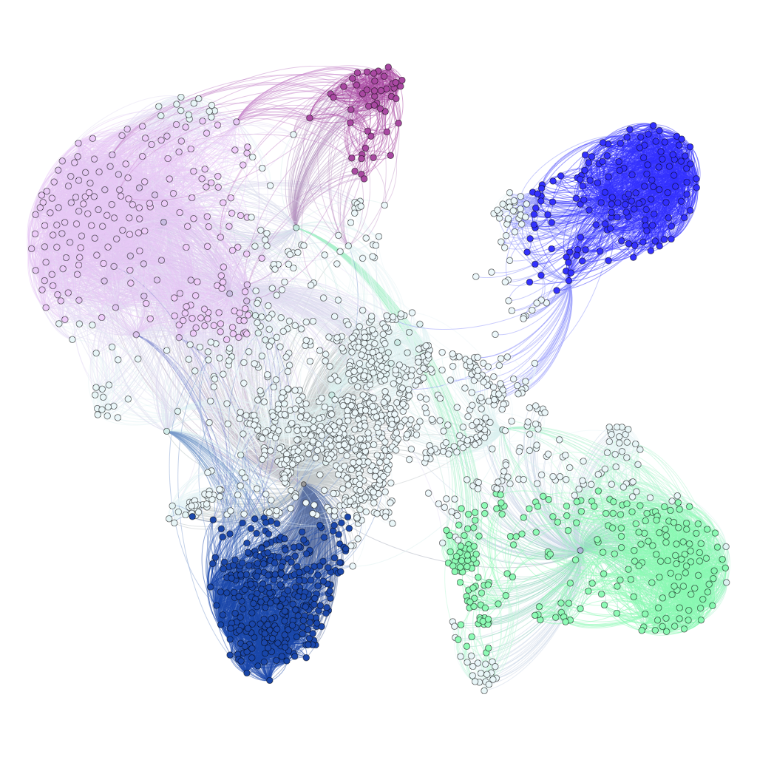
The Noisy Lens
- Several asynchronous algorithms analyzed by
a
Asynchronous Coordinate Descent
KroMagnon: Asynchronous Sparse SVRG
[Mania, Pan, P., Recht, Ramchandran, Jordan, NIPS OPT 2015]
Lock-free Correlation Clustering
[Pan, P., Oymak, Recht, Ramchandran, Jordan, NIPS2015]
Asynchronous(Algo.( INPUT )) Serial(Algo.(INPUT + Noise)
Leads to the design
of novel algorithms
KroMagnon on 16 threads up to 10^4 x faster that serial dense SVRG
8x speedup compared to serial sparse SVRG
Clustering Billion-Edge Graphs in <10 sec.
12-15x Speedup on 32 threads
(Scala Implementation, Amazon EC2 experiment)

Slide 46
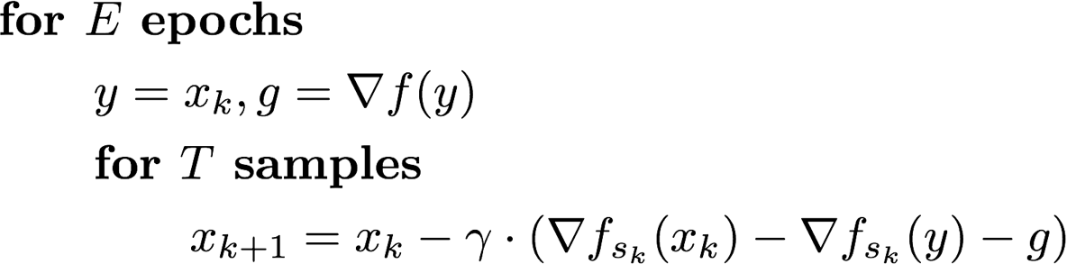
Asynchronous SVRG?
Can SGM achieve faster rates?
SVRG = yes, if you do a full grad. computation per epoch [Johnson, Zhang, NIPS13]
Issue: updates are generally dense, even for sparse functions.
When the problem is sparse:
async. SGM many times is faster than async. SVRG
Well maybe we can sparsify each iteration and then run lock-free
KROMAGNON

Slide 47
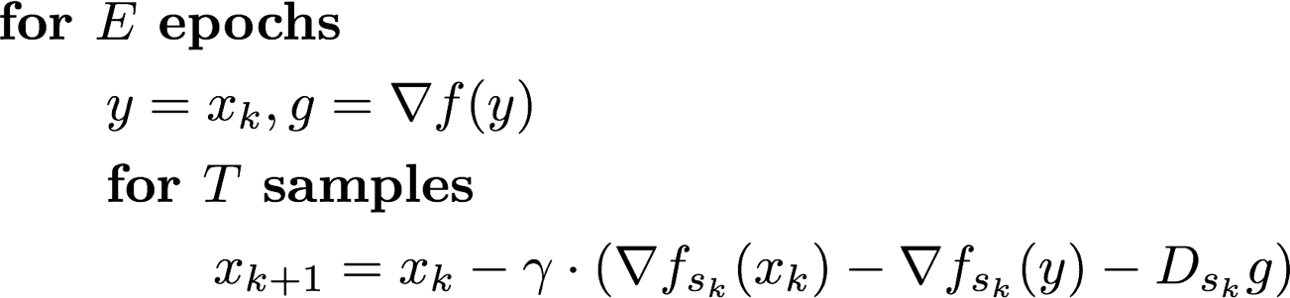
KROMAGNON
At each iteration
Support ( gradient de-biasing ) = support ( sampled hyper edge)
How do we analyze the convergence rate of KROMAGNON ?
It can be phrased in the “perturbed iterates” language
Grad computation embarrassingly parallel
Run this like HOGWILD!
Asynchrony noise
Theorem:
Assuming
KROMAGNON achieves the same rate as serial SVRG

Slide 48
Experiments
MSB:
if you want to use SVRG try sparse SVRG
can be up to 10 - 10^4 x faster

Slide 49
Open Problems

Slide 50
Open Problems: Part 1
Assumptions:
Sparsity + convexity => linear speedups
O.P. :
Hogwild! On Dense Problems
Maybe we should featurize dense ML Problems,
so that updates are sparse
Only soft sparsity needed = uncorrelated sampled gradients
O.P. :
Fundamental Trade-off
Sparsity vs Learning Quality?

Slide 51
Open Problems: Part 2
=
What we proved:
What we really care about:
O.P. :
True Speedup Proofs for Hogwild
Holy Grail
O.P. :
Guarantees for Nonconvex Problems?

Slide 52
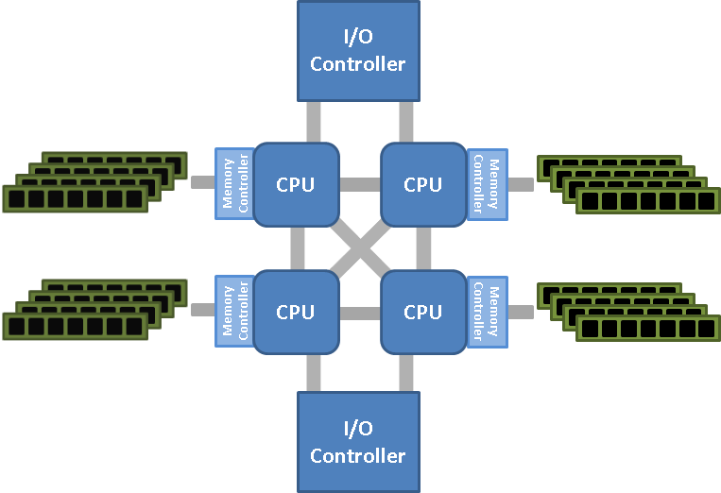
Open Problems: Part 3
Hogwild! Algorithms great for Shared Memory Systems
Issues when scaling across nodes, due to comm
Similar Issues for Distributed:
speedup
#threads
O.P. :
How to provably scale on NUMA?
O.P. :
What is the right ML Paradigm
for Distributed?

